Slide 1
Chapter 1: Investigating human biology

Slide 2
1.1 Types of investigations
Observations
Any investigation will involve some form of observation. In investigations based on observation, scientists are looking for patterns. When a pattern becomes evident it may be possible to draw tentative conclusions.
An example of an investigation based on observation is the discovery that peptic ulcers are caused by the bacterium Helicobacter pylori.
Controlled experiments
Controlled experiments, sometimes called fair tests, are designed to investigate relationships between factors (or variables). They involve changing one variable while all the other variables are kept the same. Any differences in the results should be due to the changed variable.
An example of a controlled experiment was a 1940 experiment to test the effectiveness of penicillin as an antibiotic using mice.

Slide 3
1.1 Types of investigations
Surveys
A survey is a process of systematically collecting, analysing and interpreting information about an aspect of a study. Surveys are usually designed to collect data from a large number of subjects. The information may be collected using a questionnaire or by interview. Using the large amount of information collected, the researcher can then look for patterns in the data.
Trial and error
Trial and error, when used in scientific research, is a systematic process. It involves one attempt to solve a problem being followed by another. Each trial is recorded, and the results allow the investigator to gradually home in on the solution to a problem.
Many new drugs, such as antibiotics, have been discovered using trial and error. Chemical compounds extracted from plants can be tested on cultures of bacteria to see whether they have any effect. Those that show promise can then be subjected to further testing under different conditions.

Slide 4
1.1 Types of investigations
Case studies
A case study is an in-depth investigation of one particular person or situation. For example, in medicine the progress of a particular disease in one person may be documented. Such a case study can extend or help to confirm what is already known about the disease.
Longitudinal studies
A longitudinal study is conducted over a long period of time. It is similar to a case study but is more prolonged. Longitudinal studies may take place over many years, even decades. They can also be done retrospectively, which means that the researcher can examine records of past events to build up a picture of change over time.
The Busselton Health Study is a longitudinal study of the population of Busselton, a coastal town in the south-west of Western Australia. Begun in 1966 and continuing today, it is the world’s longest-running study of the health of a population.

Slide 5
1.2 Conducting investigations
Scientific method
Many investigations lead to the testing of a hypothesis and follow a similar pattern, called the scientific method, as follows:
1 Recognise a problem and define a question.
2 Collect as much information as possible relating to the problem.
3 Propose a hypothesis – a possible explanation for the problem. The hypothesis is written as a statement that can be tested.
4 Test the hypothesis using an experiment.
5 Analyse and interpret the data collected from the experiment.
6 Draw conclusions about whether the hypothesis was supported or disproved.
7 Report on the investigation.

Slide 6
1.2 Conducting investigations
Literature review
One way of collecting information is to carry out a literature review. A literature review is a survey of the material that has been written about the subject under consideration.
The purposes of a literature review are to:
help the researcher define the problem
find out what is already known about the problem
assess research methods used by other researchers
allow researchers to relate their findings to what is already known.

Slide 7
1.2 Conducting investigations
Safety
It is important that an investigation presents no danger to the participants or to the investigators. Examine the design of your investigation to make sure that any associated safety risks are minimised and controlled. Consider the need for safety devices (fire extinguishers, fire blankets, eye washes, etc) and PPE (safety glasses, gloves, face masks and protective clothing).
For some investigations it may be necessary to assess the participants, for example, for allergies or health problems.
Safety considerations should include not just the physical safety of the people involved, but also factors such as whether the participants will feel insecure, threatened or embarrassed.

Slide 8
1.2 Conducting investigations
Ethics
Ethics are a set of moral principles or values; ethical behaviour is behaviour that conforms to those principles or values. In scientific research, particularly with human participants, many ethical issues arise.
Five principles of an ethically sound investigation include:
Voluntary participation
Informed consent
Risk of harm (should be minimised and the benefit assessed)
Confidentiality
Anonymity.
Animals must also be treated in an ethical way. Any use of animals in research should be valid, humane, justifiable and considerate.

Slide 9
1.2 Conducting investigations
Controlling variables
A variable is any factor that may change during an experiment. In an investigation, variables are classified as either independent, dependent or controlled.
• The independent variable is the factor that is being investigated. This means that it is the factor that is deliberately changed to determine how it affects the results (also called the experimental variable or the manipulated variable).
• The dependent variable is the factor that changes due to the changes made to the independent variable (also called the responding variable). The hypothesis should state the predicted relationship, or trend, between the independent variable and the dependent variable.
• Controlled variables are the factors that are kept the same for both the control and experimental groups in an experiment.
Sometimes it is difficult or impossible to keep all variables the same. Uncontrolled variables are variables that are not kept the same for the control and the experimental groups in an experiment. must be taken into account when interpreting the results.

Slide 10
1.2 Conducting investigations
Repetition and replication
Scientific experiments always involve repetition or replication. Repetition means doing the same experiment many times. Replication means having a number of identical experiments running together or performing the experiment on a large number of subjects at the same time.
Both help to demonstrate that results are consistent. If results are different each time an experiment is performed, they are of little value.
Repetition and replication can also help to overcome the effects of uncontrolled variables.
In designing any experiment, plan for as much repetition or replication as time and resources will allow.

Slide 11
1.2 Conducting investigations
Validity, accuracy and reliability of results
When an experiment tests what it is supposed to test, it has validity. If not it is invalid.
Experiments can also be invalid if there are uncontrolled variables – that is, if there are factors that could affect the result of an experiment that are not kept the same for the experimental and the control set-ups.
The accuracy of data refers to how close the data is to the exact value. Accuracy is dependent on the equipment used, which needs to be calibrated correctly.
Reliability is the extent to which an experiment gives the same result each time it is performed. The measuring instruments used in the experiment must also be reliable; that is, they must give the same measurement each time they are used.
Repetition and replication are used to identify that results are reliable, but they do not improve the accuracy of the experiment.

Slide 12
1.2 Conducting investigations
Types of data
Data from an investigation can be one of two types:
quantitative data – expressed in numbers and usually involving measurement; for example, ‘the students are 174 and 176 cm in height’
qualitative data – observations that do not involve numbers or measurement; for example, ‘student A is taller than student B’.
Wherever possible, you should design an investigation so that the results are quantifiable.
Secondary data
Secondary data is data that has been collected by someone other than the people who are using the data.

Slide 13
1.2 Conducting investigations
Errors and limitations in data
It is important that data is checked carefully for errors. In science, an error is not necessarily a mistake. Rather, it is any deviation from the result that should have been obtained. One of the reasons why scientists provide comprehensive reports on their investigations is so that others can check their data for errors.
Measurements made with any measuring instrument are approximate. This may be because there is natural variation in the subject, variation in the measurement process, or both. This uncertainty in measurement is called measurement error.
It is also important to understand the limitations of data obtained from an investigation. You must not draw conclusions that go beyond the data.
Data may sometimes include a confidence interval. A confidence interval is used to indicate the reliability of data. It is the range of values above and below a result in which the actual value is likely to fall, e.g. plus or minus 1.5%. A confidence interval should be quoted along with a confidence level. The confidence level most commonly used in research is 95%.

Slide 14
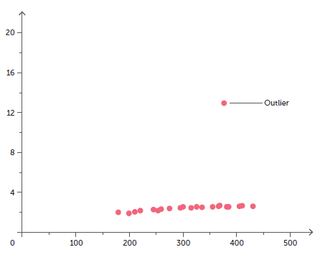
1.2 Conducting investigations
Processing data
Average
In science a description of a set of numbers almost always includes a measure of its centre, or its average. The average that is most often calculated is the arithmetic mean, or the mean. To calculate the mean of a group of measurements, add up all the measurements in the group and divide by the total number of measurements.
Sometimes in a set of measurements there will be values that are well beyond the range of the rest of the measurements. These are called outliers, and they affect the mean. Outliers may result from mistakes in measurement, the failure of equipment or other errors. If the outliers clearly result from an error, they may be excluded when the mean is calculated.

Slide 15
1.2 Conducting investigations
Median
The median is the middle of a set of numbers. It divides the lower set of numbers from the upper set. If there is an even number of measurements, then the median is taken as the mean of the two values in the middle of the set of numbers.
Using the median of a set of numbers reduces the influence of outliers.
Range
A measure of the centre of a group of numbers can be misleading. The mean, or the median, gives us no idea about whether all the values are clustered around the centre or whether there is a very wide spread from highest to lowest value. Any description of a set of numbers should therefore include both a measure of centre and a measure of spread.
The simplest way to indicate the spread is to quote the range – that is, the highest and lowest measurements in the group.

Slide 16

1.2 Conducting investigations
Ratios and rates
A ratio is a numerical statement of how one variable relates to another. That is, it is a comparison of two numbers. Ratios are written as two numbers separated by a colon. For example, modern widescreen TVs have a ratio of 16:9.
A rate is a special kind of ratio that shows how long it takes to do something. For example, a very good athlete can run 10 000 m (10 km) in around 30 minutes. This is a rate of 1 km per 3 minutes, or 20 km per hour. Rate is much more meaningful than a simple count of how often something occurs.
Percentages
Percentages are used to express how large one variable is in relation to another. For example, if a breakfast cereal is labelled as containing 1.5% fat, it means that 100 g of the cereal contains 1.5 g of fat.
Percentage change
Calculating a percentage increase or decrease is often a good way to understand changes in a variable over time.

Slide 17
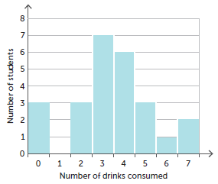
1.2 Conducting investigations
Frequency
Frequency is the number of times an event occurs. For example, some students conducted a survey to find out how many drinks containing caffeine were consumed by the members of their class in a two-day period. The table of data they collected is called a frequency distribution or frequency table (see next slide). A frequency table summarises the data by showing how often the variable in question occurs. Frequencies can also be presented graphically as a histogram.

Slide 18
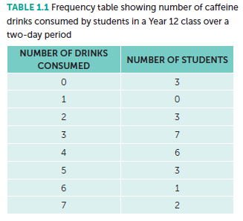
1.2 Conducting investigations
Presentation of data
Tables
A table is an organised and concise way of presenting data. Include an informative title, present the data in columns, and ensure each column has a heading that names the variable and the units in which it is measured.

Slide 19
1.2 Conducting investigations
Graphs
A graph shows how changes in one variable affect a second variable. From a graph it is easy to see any trends in the data. It is also possible to predict what the values would have been between the points plotted (interpolation), or the trend beyond the data shown in the graph (extrapolation).
When drawing a graph:
• Include a title that states the two variables shown on the graph.
• Plot the independent variable on the horizontal axis and the dependent variable on the vertical axis
• Label each axis with one of the variables and the units in which it is measured.
• Use a scale with equal intervals of units on each axis.

Slide 20
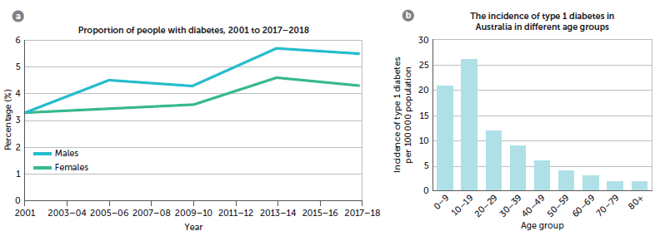
1.2 Conducting investigations
The most commonly used graphs are line graphs (for continuous data), histograms (for frequencies) and, column graphs and bar graphs (for discrete data).
Line graph
Column graph

Slide 21
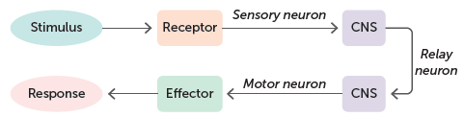
1.2 Conducting investigations
Models
In science, a model is a simplified representation of an idea or process. Once a model has been developed it can be applied to a number of situations. The model for the scientific method can be applied to most scientific investigations.
A model may be a diagram, a flow chart or a physical model such as a model of the atoms in a protein. Scientific models often have to be modified as new data is collected.
Flow charts
A flow chart is a diagram that shows the steps involved in a process. The steps are usually shown in boxes and the sequence of steps is indicated by arrows. Flow charts are very useful in summarising and visualising the steps in a complex process.
Flow chart for a reflex

Slide 22
1.3 Reporting on scientific investigations
Scientific reports
When an investigation has been completed, the findings need to be made known to others. This is usually done by a scientific report. The standard format includes:
title of the report and name of the author/s
introduction, stating the nature of the problem investigated and the hypothesis tested
materials and equipment, listing the apparatus used
method, describing the exact method used to carry out the investigation
results, often presented as tables, graphs, diagrams or photographs
discussion, including comments about the results and the way they relate to the hypothesis that was tested as well as an evaluation of the investigation (usually the most important and longest part of a report – must be very thorough)
conclusion, summarising the most important parts of the discussion and stating whether or not the hypothesis was supported

Slide 23
1.3 Reporting on scientific investigations
cont…
further research, as scientific investigations often raise more questions than they answer – many reports suggest areas that need further investigation
references, which list any reports, books, journal articles, websites or other sources of information referred to in the report
acknowledgements, of people who helped with the investigation or of organisations that provided funds for the research.
The editors of scientific journals use a process called peer review to make sure that the report is worthy of publication. A submitted report is sent to one or more scientists who are experts in the field and who may or may not recommend publication.

